Slide 1

Data Visualization in Tennis
Peter Tea

Slide 2
Introduction & Background Information
Notes:
Explain Tennis jargon

Slide 3
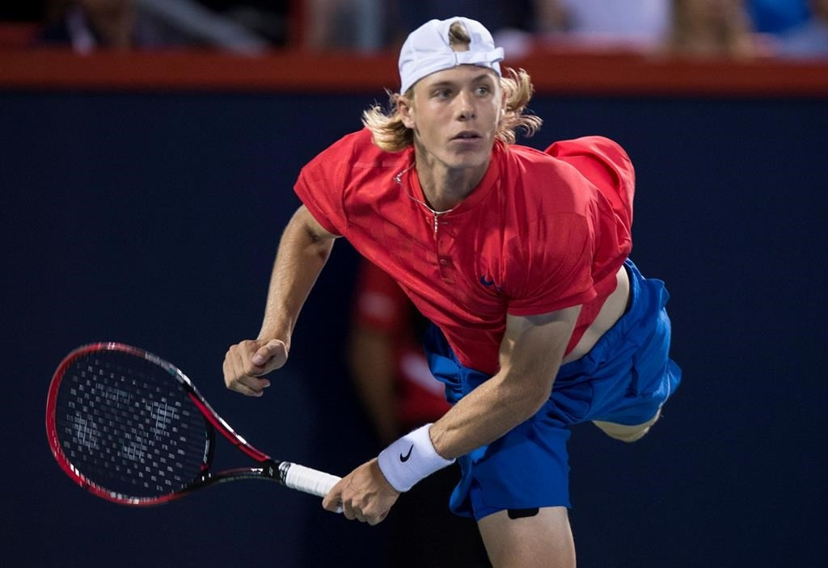
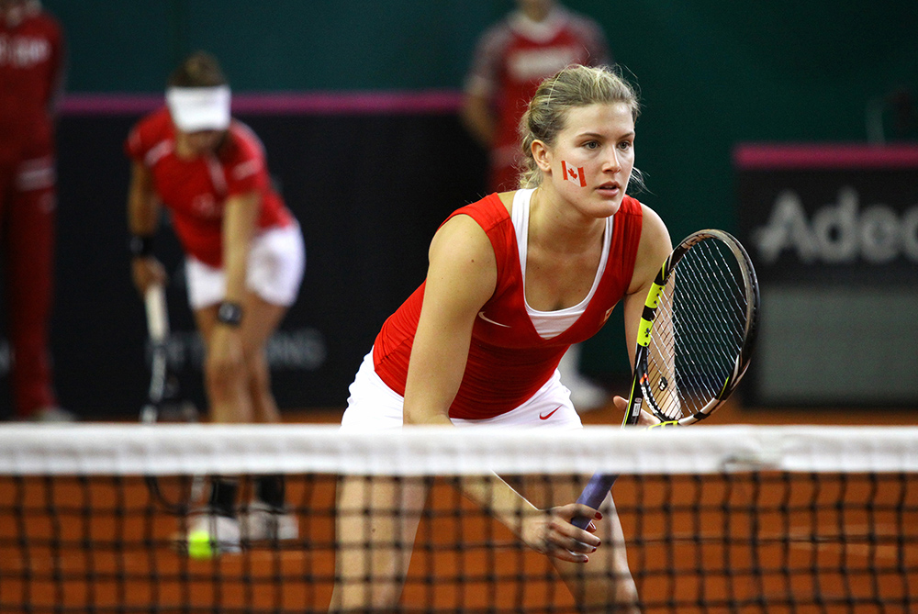
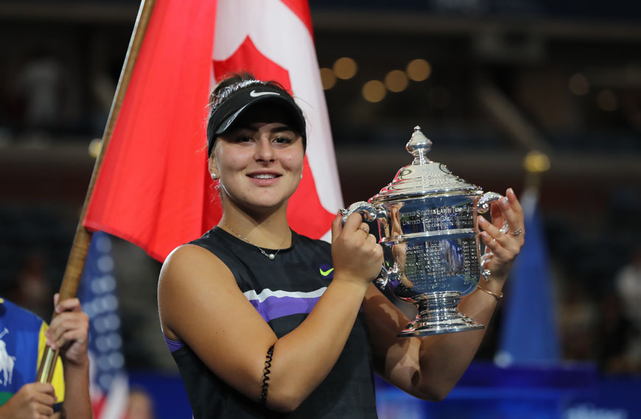
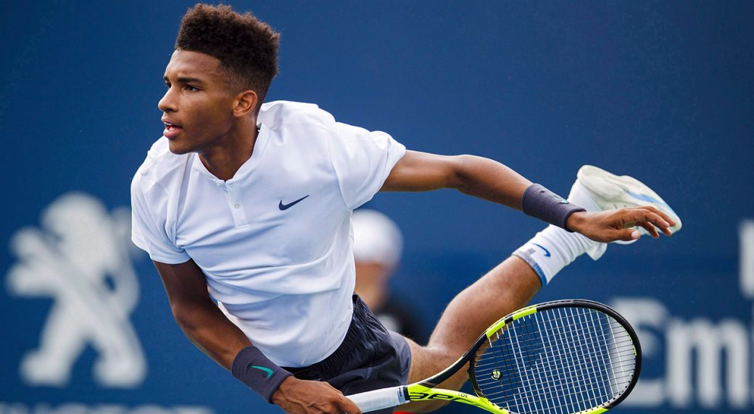
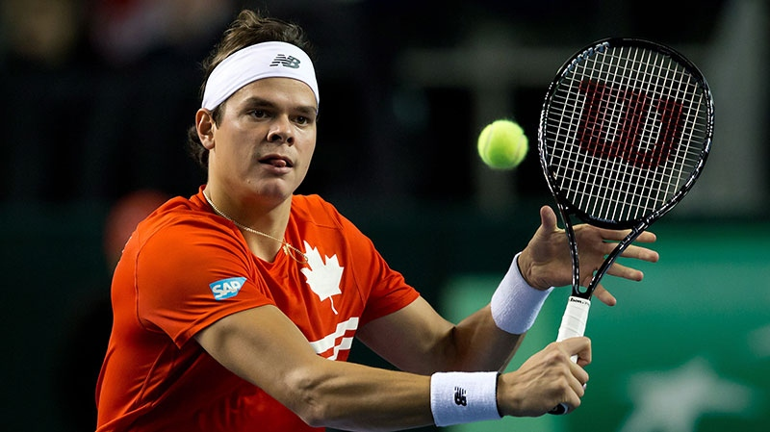
Canadian Tennis Stars
Andreescu (Age 19); 2019 US Open Champion; 5th WTA
Raonic (Age 28); 2016 Wimbledon Runner Up; 31st ATP
Auger-Aliassime (Age 19); 21st ATP
Bouchard (Age 25): 2014 Wimbledon Runner Up; 220th WTA rank
Shapovalov (Age 20); 15th ATP
Notes:
Bianca Andreescu: Age 19; US OPEN Winner 2019; Currently ranked 5th in WTA standings
Milos Raonic: Age 28; Runner up Wimbledon 2016 (def. Andy Murray); Currently ranked 5th in WTA standings
Shapovalov: The youngest to crack the top 30 since 2005
Bouchard reached Semi finals of 2014 Aus Open and French Open (Reached 5th rank in 2014)

Slide 4
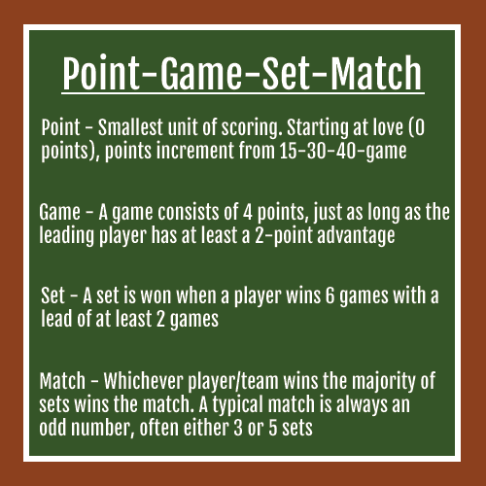
How to keep score in Tennis matches
Points → Games → Sets → Match!
0 Points — Love
1 Point — 15
2 Points — 30
3 Points — 40
4 Points — Game (Need to win by 2)
Grand slam matches are played best out of 5 sets
Notes:
http://protennistips.net/tennis-scoring-system/
All — Used to describe even scores, except for 40-40. A score of 0-0 would be love-all, 15-15 would be 15-all, and 30-30 would be 30-all.
Deuce — Used to describe a score of 40-40. If a deuce is reached, a player must win 2 consecutive points in order to win the game. If a player wins one point and then loses the next point, the score returns to deuce.
Advantage — The player who wins the first point after a deuce is reached is said to have “advantage”.
Advantage In — If the server is the player who has advantage, the server may announce the score as “advantage in”.
Advantage Out — If the receiver is the player who has advantage, the server may announce the score as “advantage out”.
Tennis scoring system believed to have originated from medieval French
Tie-break set - The player or team must win at least 7 games (best of 12) with a 2-game advantage over their opponent(s).

Slide 5
Which Country contributes the most Tennis Talent?
Ranking scores - merit-based method used for determining entry and seeding in all tournaments.
For each player, final ranking scores considers 4 grand slams, 8 Masters 1000 and the best 6 results from ATP tour 500/250s
Notes:
(4) Grand Slams, the eight (8) mandatory ATP Tour Masters 1000 tournaments and the Nitto ATP Finals of the ranking period, and his best six (6) results from all ATP Tour 500, ATP Tour 250

Slide 6
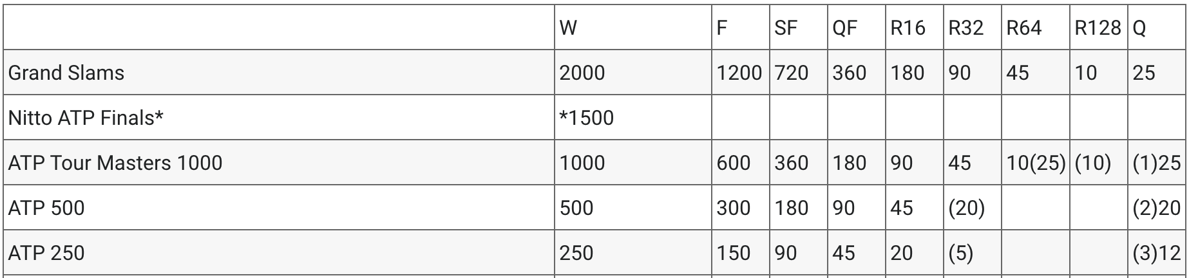
Ranking Points
3 types of tournaments in a tennis season:
Grand Slams
Masters 1000
ATP tour 500/250
Notes:
https://www.atptour.com/en/rankings/rankings-faq

Slide 7
ATP World
Notes:
ATP = Association of Tennis Professionals

Slide 8
WTA World
Notes:
WTA = Women’s Tennis Association

Slide 9
Other metrics for Tennis success?
Prize Money won
# of players in the top 100
# of consecutive weeks a player holds top rankings
Player rankings are based only on how deep a player goes into a tournament (it does not take into account the quality of opponents defeated)

Slide 10

Serving Strategies in Tennis
70% of all points are won in 4 shots or less
Belief: Tennis players who have an outstanding first serve, reduce the power and play the second serve safe.
Players sacrifice power for more consistency and accuracy
Notes:
The tennis serve is the most important shot in tennis
you are hitting a serve to start the point. Starting anything off on the right foot is a big key to success.
A strong service game gives you more control on offense
How well you begin the point has a significant effect on how well you end the point
Serve and volley is a style of play in tennis where the player serving moves quickly towards the net after hitting a serve. The server then attempts to hit a volley (a shot where the ball is struck without allowing it to bounce), as opposed to the baseline style, where the server stays back following the serve and attempts to hit a groundstroke (a shot where the ball is allowed to bounce before contact is made).

Slide 11
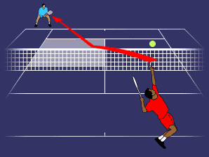
Tennis Serving Rules
Server has only two opportunities to serve legally
The serve must pass over the net and hit the service court that is diagonally opposite the server
Serving faults: Foot faults (feet must be behind baseline)
Let serves:
The served ball touches the net, and lands in the correct court
The ball is served when the receiver is not ready
When it is a let serve, that particular serve does not count and the server shall serve again
Notes:
The server alternates serving from the two halves of the court.
In both a standard game, and tie-break game, the server begins by serving from the right half of the court.

Slide 12
2019 ATP Wimbledon
Notes:
Djokovic def. Federer

Slide 13
2019 ATP US Open
Notes:
Nadal def. Medvedev

Slide 14
2019 WTA Wimbledon
Notes:
Halep def. Williams

Slide 15
2019 WTA US Open
Notes:
Andreescu def. Williams

Slide 16
Other Tennis Questions
Calculate success points won on 1st serve compared to 2nd serve
Calculate length of rally of points on 1st serve compared to 2nd serve
Somehow incorporate depth of serve into a compound statistic with serve speed. A matric that describes a “good serve” should take into account placement and speed (good placement can throw players off balance)
Is there a hidden “shift” tactic that a receiver can abuse?
Estimate career age curves (project player careers)

